Slide 1
Plug-in Development Tips, Tricks and Best Practices
“In PDE we do tooling, but our business is people”
Chris Aniszczyk <zx@us.ibm.com>
PDE Lead
Eclipse Committer
Notes:
Note: Mention that this is focused on plug-in development, not building plug-ins

Slide 2


Agenda
Plug-in Development with PDE
Tips, Tricks and Best Practices
Q&A

Slide 3
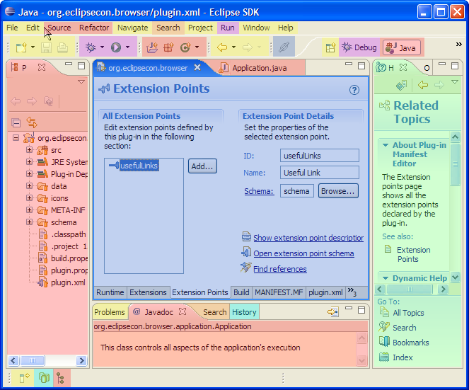
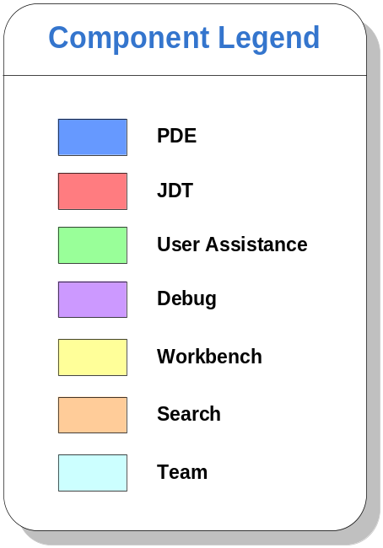
Seamless Integration of Components

Slide 4
PDE
PDE = Plug-in Development Environment
Tools to develop Eclipse plug-ins
  Wizards to create, import and export plug-ins and features
  Specialized editors for plug-in manifest files
  Templates for new plug-ins
  Launchers to run, debug and test plug-ins
  NLS tools to internationalize plug-ins
  Automated class path management

Slide 5
PDE Details
PDE is implemented as a set of plug-ins
PDE is built on top of the Eclipse Platform and JDT
  Uses Eclipse Platform and JDT extension points and APIs
PDE is seamlessly integrated into Eclipse
PDE gets no special treatment from the Platform or JDT

Slide 6
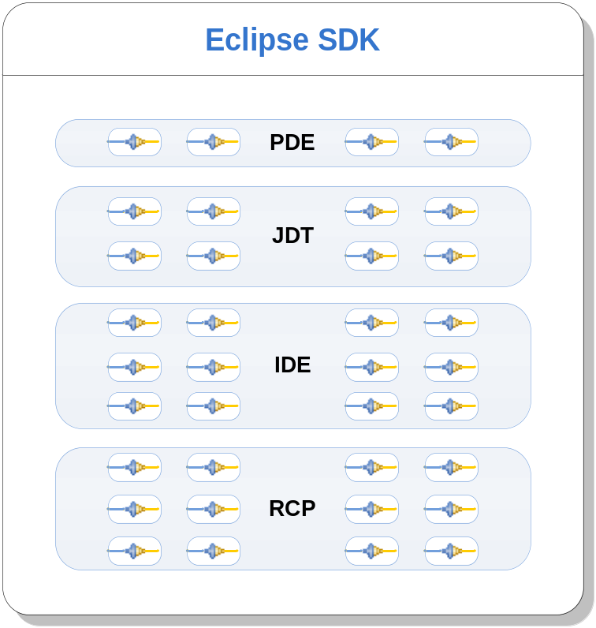
Plug-ins All the Way Down
A plug-in is the fundamental building block of an Eclipse product
Plug-ins build on top of and use other plug-ins
To extend Eclipse, you must write plug-ins
To write a rich client application, you must write plug-ins

Slide 7

Agenda
Plug-in Development with PDE
Tips, Tricks and Best Practices
Q&A

Slide 8
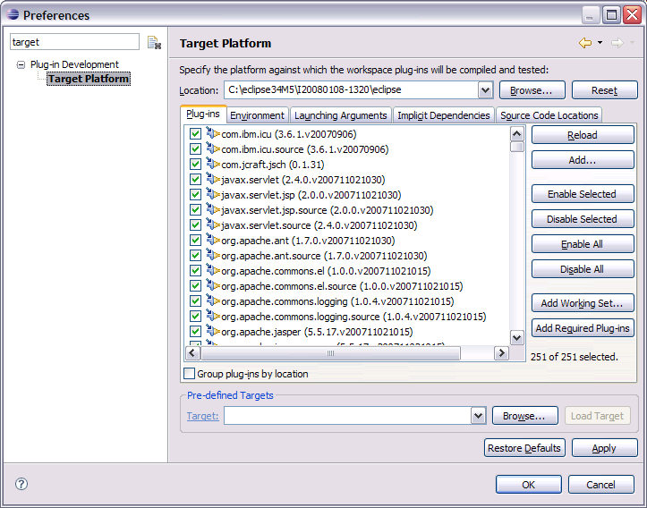
Target Management
Helps you to specify plug-in in which to build and run with.
Includes tabs to set environment values, launching arguments, implicit dependencies, and source code locations.
You can add plug-ins to the current target platform by using target provisioners. Current provisioners allow you to specify locations on your file system and the locations of update sites.
The plug-ins can be viewed as a list or a tree (separated by locations).

Slide 9
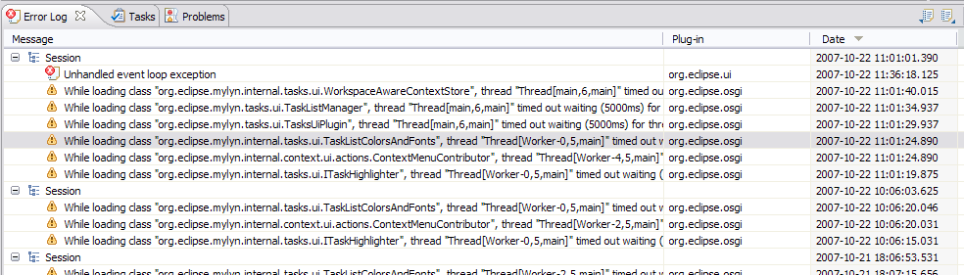
Error Log
More than meets the eye…
Group log entries by
  Session
  Plug-in

Slide 10
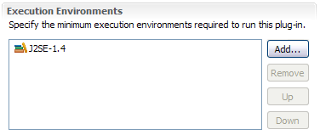
Execution Environments
Execution Environments are symbolic representations of JREs
Bundle-RequiredExecutionEnvironment (BREE) manifest header
PDE Build uses BREE to determine compile settings
http://wiki.eclipse.org/Execution_Environments

Slide 11
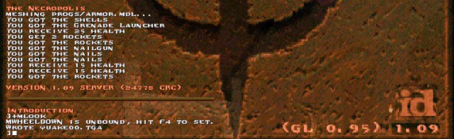
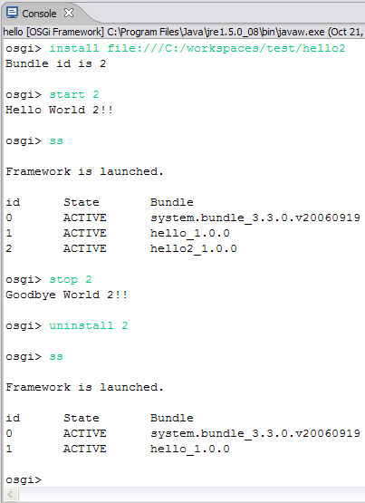
OSGi Console
Integrate with the console that drives Eclipse
Common commands
  Status
  Start/stop
  Install/uninstall
  diag
Custom Commands
http://www-128.ibm.com/developerworks/opensource/library/os-ecl-osgiconsole/

Slide 12
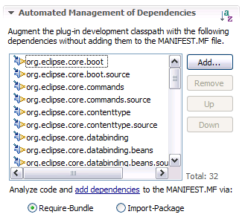
Automated Management of Dependencies
Allows you to concentrate more on writing code than composing dependencies in your MANIFEST.MF.
Helps inexperienced users formulate dependencies in their MANIFEST.MF so they can quickly create and run plug-in projects without in-depth knowledge of OSGi.
Update stale manifest files prior to launching to ensure project will run correctly.
Notes:
You must first set up a list of possible dependencies, or all the plug-ins in your targeted environment, in the Automated Management of Dependencies section of the Manifest Editor. This allows you access to all the classes in the specified plug-ins. To search for dependencies in your code and add them to your MANIFEST.MF, simply click on the add dependencies hyper link in the same section.
You are able to configure how the dependency is resolved, whether through Import-Package or a Require-Bundle.
You must first set up a list of possible dependencies, or all the plug-ins in your targeted environment, in the Automated Management of Dependencies section of the Manifest Editor. This allows you access to all the classes in the specified plug-ins. To search for dependencies in your code and add them to your MANIFEST.MF, simply click on the add dependencies hyper link in the same section.
You are able to configure how the dependency is resolved, whether through Import-Package or a Require-Bundle.

Slide 13
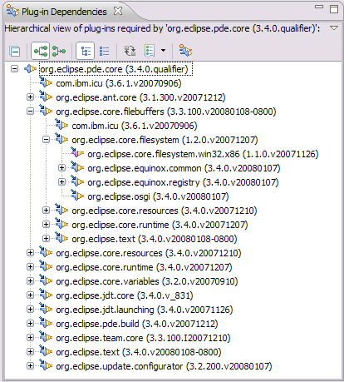
Plug-in Dependencies View
The Plug-in Dependencies view allows you to see all the dependencies for any plug-in project.
You not only see what plug-ins a project depends on, but also what plug-ins depend on that project (callers and callees).
It also can display the current state, including dependency wiring, of the plug-ins in the workspace and target platform. This will aid in finding resolution problems.

Slide 14
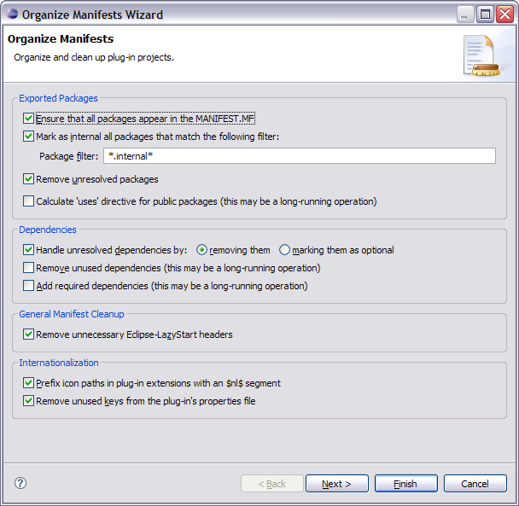
Organize Manifests Wizard
Helps you modify and format your MANIFEST.MFs
Accessible by right clicking on a MANIFEST.MF and selecting PDE Tools > Organize Manifest
Helps you:
  Export all packages in a project
  Remove unresolved packages
  Mark exported packages as internal
  Modify unresolved dependencies (removing or making them optional)
  Remove unused dependencies
  Calculate dependencies (using Dependency Management)
  Prefix icon paths with $nl$
  Remove unused NLS keys
  Calculate ‘uses’ directives

Slide 15
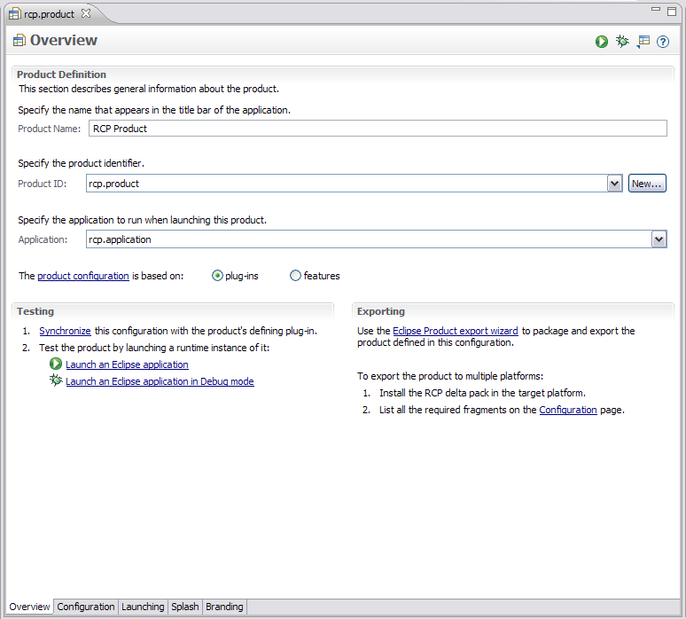
Product Editor
A product definition helps you to easily customize, test and export an RCP/Eclipse application
Customizations include:
  Modifying which plug-ins are included
  Create a splash screen
  Bundling a JVM
  Name for the launcher executable
  Specify program and launching arguments
  Define a welcome page and About dialog

Slide 16
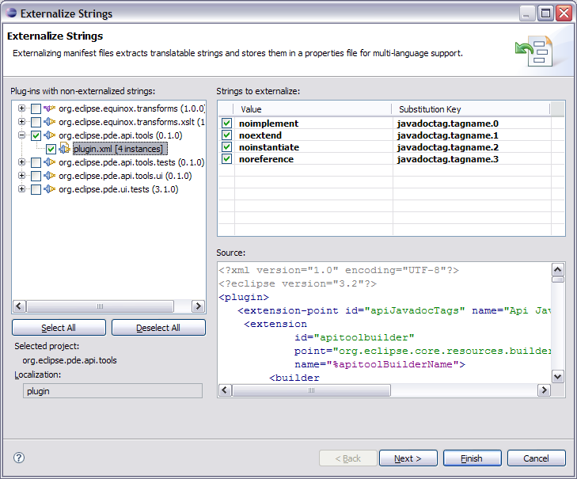
Externalization Strings Wizard
PDE’s Externalize Strings wizard allows you to quickly locate and painlessly externalize values in a plug-in’s MANIFEST.MF and plugin.xml.
Accessible by right clicking on a MANIFEST.MF or plugin.xml and selecting PDE Tools > Externalize Strings…
Externalized values are put in a file specified by the Bundle-Localization header. The default value for this file is “plugin.properties

Slide 17
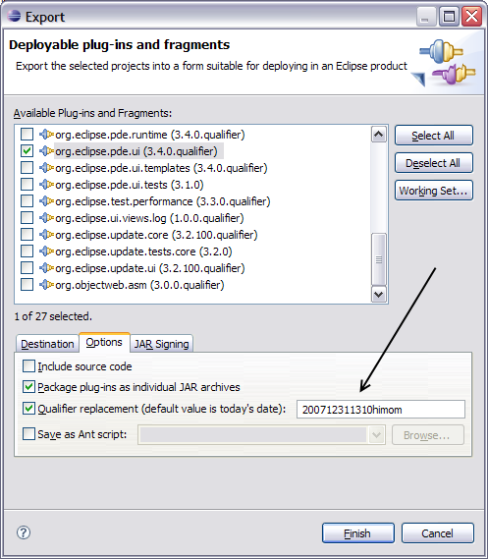
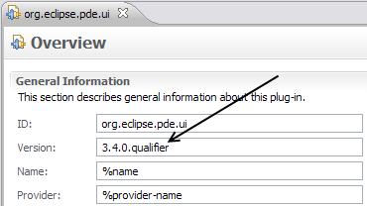
.qualifier is awesome
The “.qualifier” marker allows you to easily substitute a value for the micro segment of a plug-in or feature’s version.
The date is the default value, but you substitute any value when exporting your project using the PDE export wizards.

Slide 18
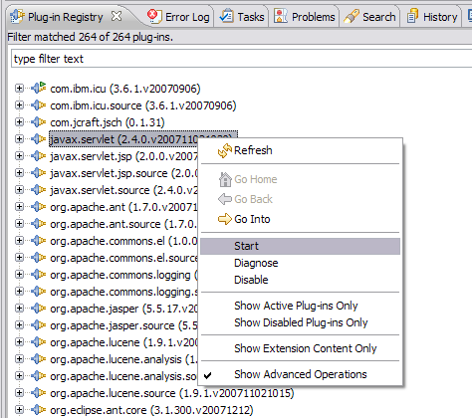
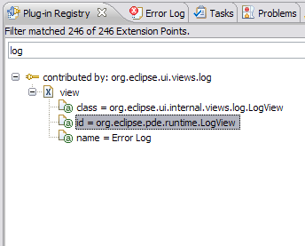
Plug-in Registry View
The Plug-in Registry view is your eye into the runtime
Show Advanced Operations
  start/stop bundles
Show Extension Content Only
  quickly browse extensions

Slide 19
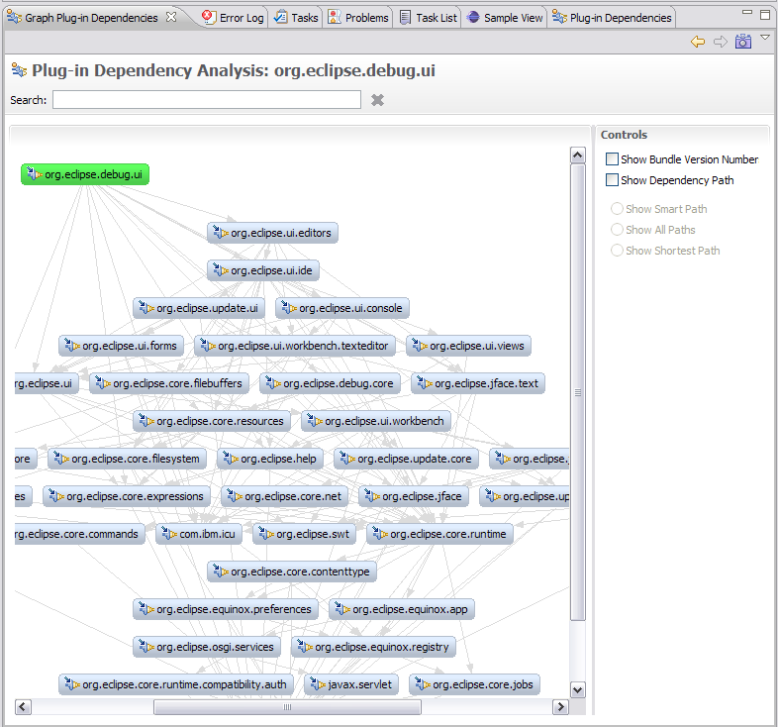
Graph Plug-in Dependencies View
PDE Incubator Project
Visualize your dependencies
Pictures are worth a thousand words
  * http://www.eclipse.org/pde/incubator/dependency-visualization/

Slide 20
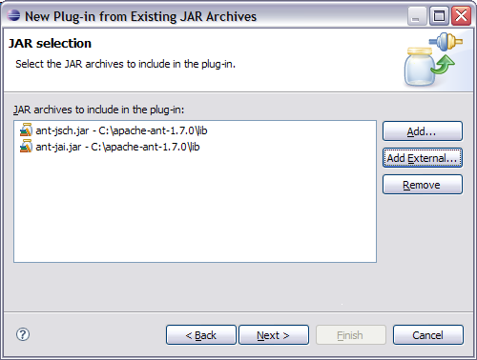
Plug-in Project from existing jars
The Plug-in Project from Existing Jars wizard enables you to quickly convert jar files to plug-ins.
Helpful when an application is being converted to OSGi and it depends on certain library jars
Can be very useful for utility jars, as they can be shared across multiple plug-ins instead of requiring the jars be included in each plug-in
Embedded JARs are evil

Slide 21
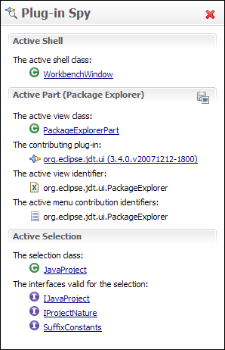
Plug-in Spy (3.4M3)
ALT+SHIFT+F1
Allows you to introspect what you’re looking at…
Hyperlinking
Shows contributing plug-ins

Slide 22
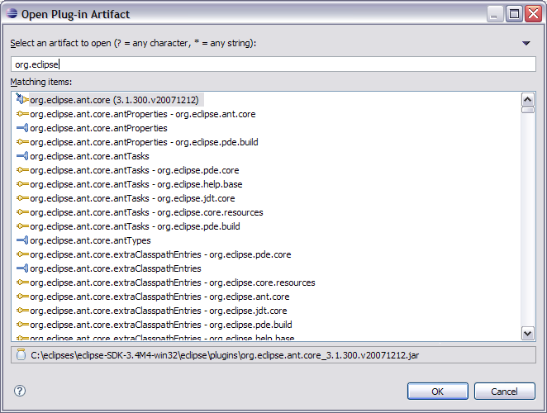
Open Plug-in Artifact (3.4M4)
Ctrl+Shift+A
Quickly browse plug-ins, extensions and extension points

Slide 23
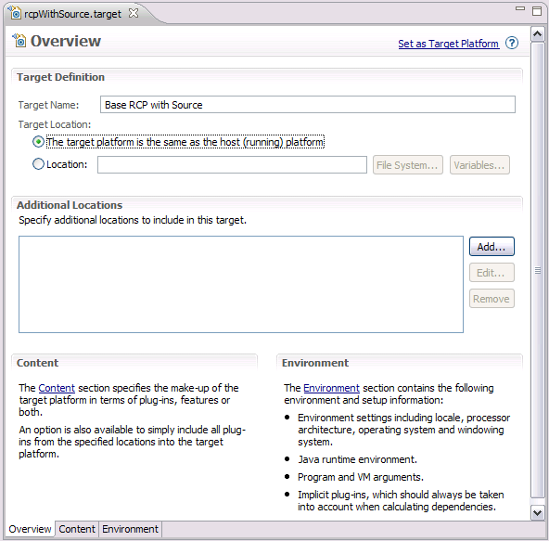
Target Editor
A target definition if a file that helps to configure your PDE development environment.
They can be created in the workspace or loaded from plug-ins who define them in your platform.
Notes:
Includes the ability to set:
the target platform location and additional directories
The target environment
The default JRE
Default vm and program arguments
Implicit plug-ins

Slide 24
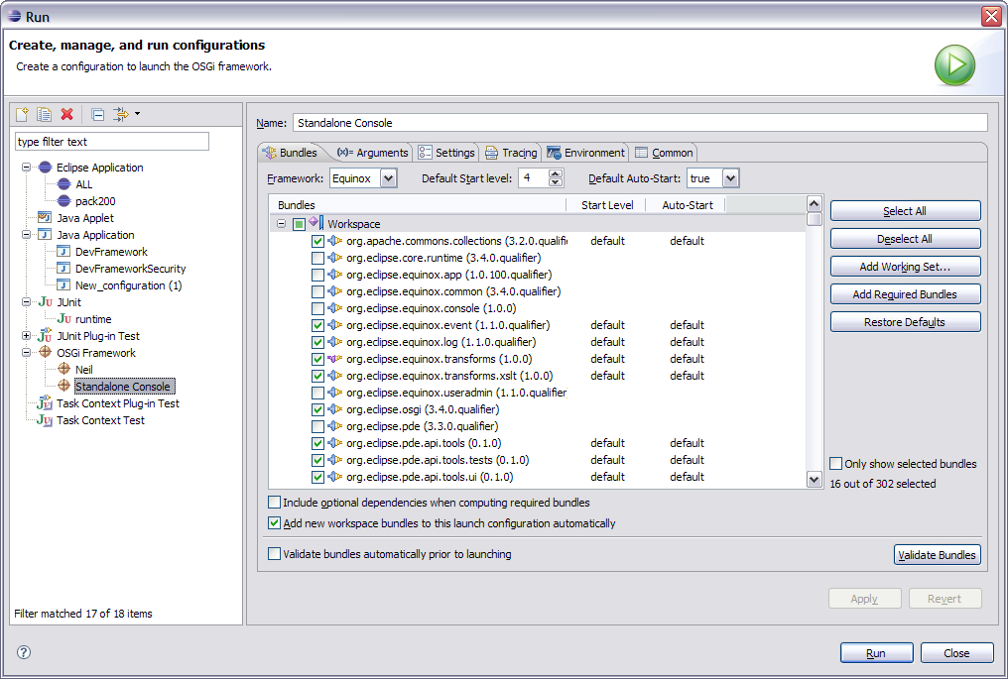
OSGi Launch Configurations
Provides a way to easily run and test your bundle in an OSGi environment.
Extensible framework that allows other OSGi runtimes to provide implementations to let users test on runtimes other than Equinox
Gives users more advanced control, including the option to specify start levels for individual bundles.

Slide 25
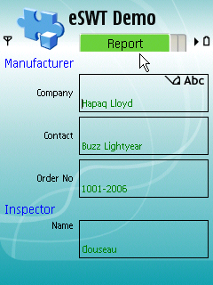
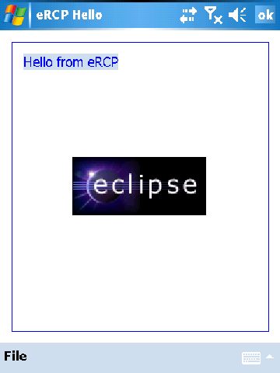
Embedded Rich Client Platform (RCP)
embedded Rich Client Platform: RCP meets device!

Slide 26
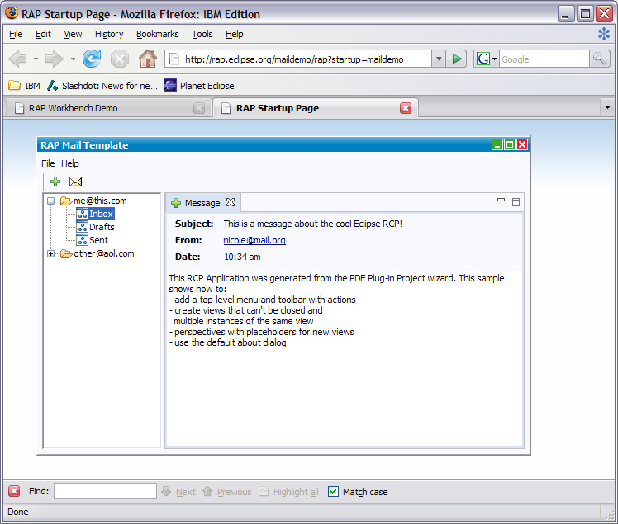
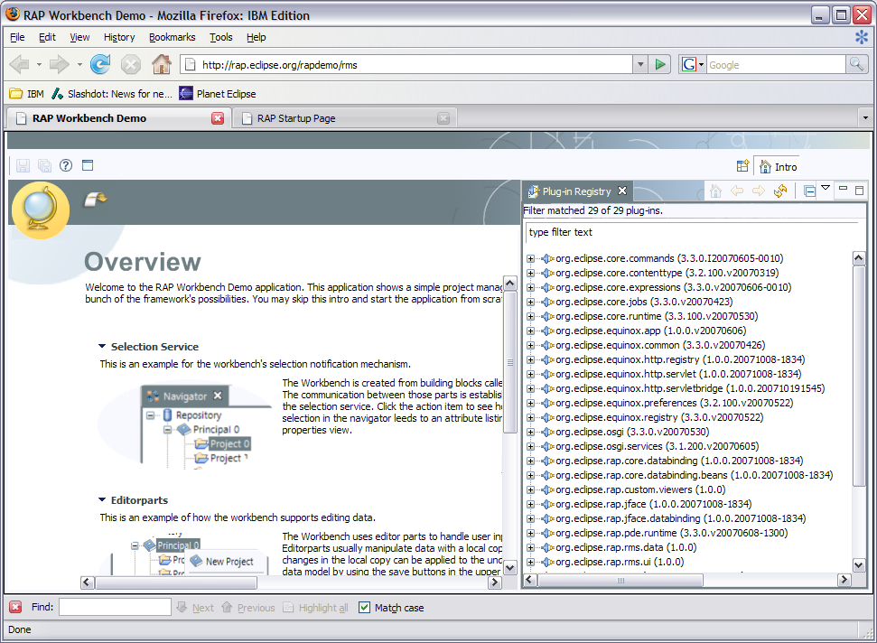
Rich Ajax Platform (RAP)
Rich Ajax Platform (RAP): RCP meets the Web!

Slide 27
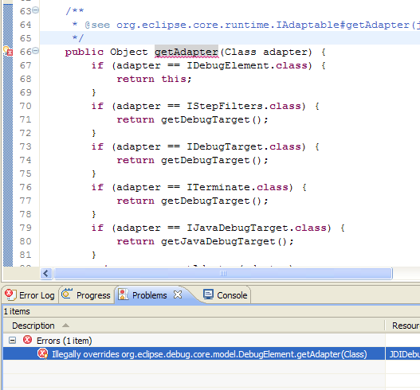
API Tooling (3.4M6)
API tooling will assist developers in API maintenance by reporting…
  API defects such as binary incompatibilities
  incorrect plug-in version numbers
  missing or incorrect @since tags
  usage of non-API code between plug-ins

Slide 28

Agenda
Plug-in Development with PDE
Tips, Tricks and Best Practices
Q&A

Slide 29

Conclusion
http://www.eclipse.org/pde
Want to contribute?
  PDE Bug Day
  http://wiki.eclipse.org/BugDay
Thank you!

Slide 30
Questions?

